Slide 1
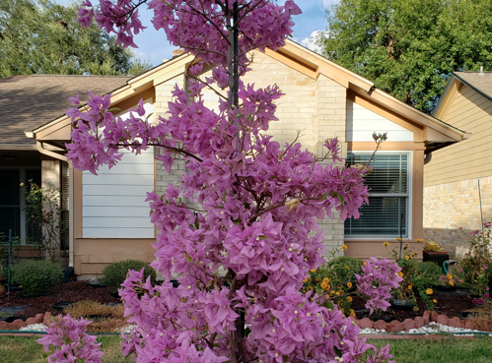

Slide 2

Healing and Peace

Slide 3
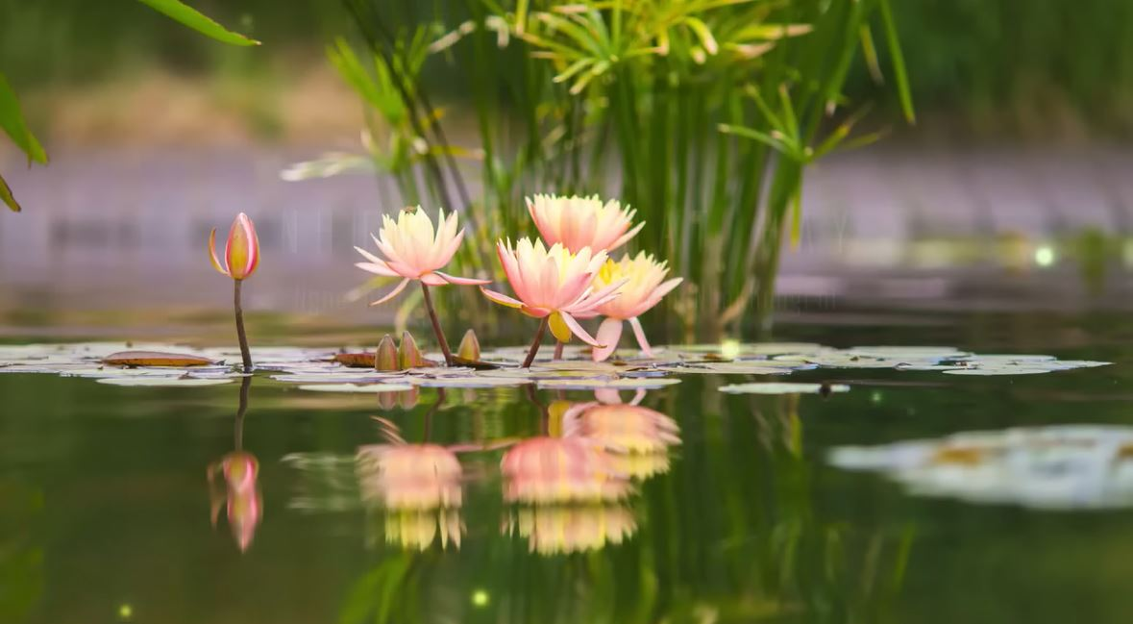
Healing and Peace

